Slide 1
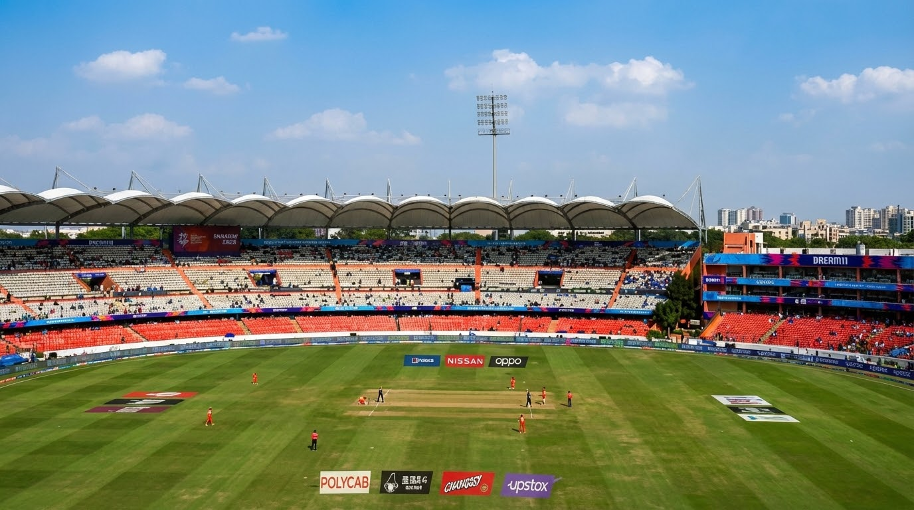

Uncovering the Indian Batting Downfall (2015–2025)
A Machine Learning Analysis of Home Performance Trends
Kotteda Gaurav | MBA-IT | Fundamentals of Data Science Project
PRN: 25030141024

Slide 2
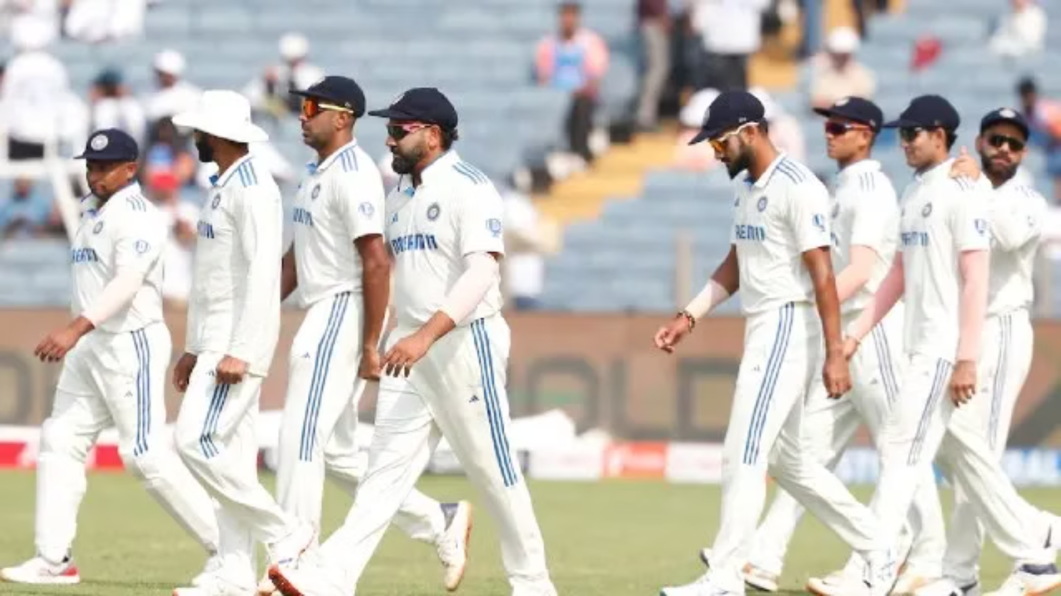
Introduction
India has historically been dominant in home Test cricket due to familiar and spin-friendly conditions.
From 2017–2024, India hosted major Test series against teams like the Australia national cricket team, England cricket team, New Zealand national cricket team, and South Africa national cricket team.
India maintained a very strong win record at home during this period.
However, recent matches show inconsistent batting and lower team totals.
This makes Indian home Tests an interesting case for performance analysis.

Slide 3

Problem Statement
The Context
The Problem
India's historical dominance at home has been challenged in recent years. The fortress that once intimidated visiting teams now shows vulnerabilities.
High-profile batting averages have dipped significantly, and innings totals are shrinking. What was once a 400+ average first innings score is now frequently below 300.
The Question: Is this due to worsening pitch conditions, tactical shifts from T20 influence, or specific technical weaknesses against spin bowling?

Slide 4
Workflow Diagram
Data Ingestion and Cleaning
Feature Engineering and Encoding
Model Preparation
Predicting Values
Training Model

Slide 5



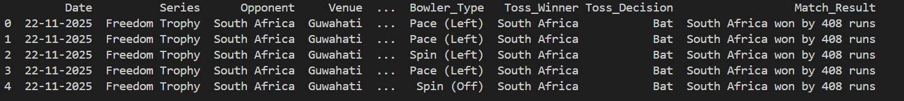
Data Source
Dataset
Volume
Key Attributes
Historical match-level data from Indian home matches spanning 2015-2025
208 data points capturing comprehensive match details
Runs scored, Date, Venue, Opponent, Pitch Rating (1-5), Bowler Type, Toss Decision

Slide 6
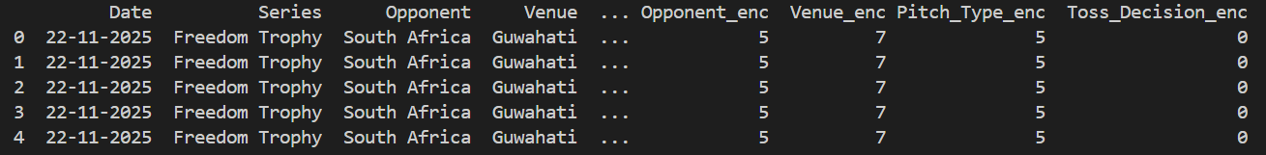
Label & Feature Encoding
Label Encoding
Feature Engineering
Transformed text categories including Opponent, Venue, and Pitch Type into unique integers using LabelEncoder for model compatibility.
Split Bowler_Type into two specific binary columns to pinpoint exactly which bowling style triggers performance downfall:
Ordinal Encoding
Is_Spin (1 for Spin, 0 for Pace)
Is_Left_Arm (1 for Left, 0 for Right)
Applied to Role (e.g., Top Order, Middle Order, Lower Order) because batting position has a logical hierarchy that impacts scoring patterns.

Slide 7
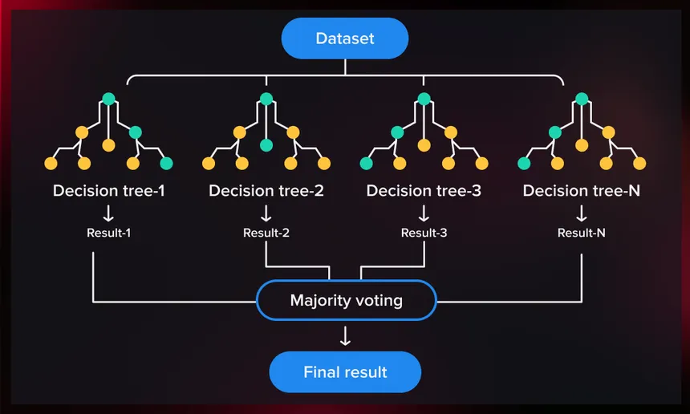
Model Implementation: Random Forest Regression
The Choice
How it Works
Random Forest Regressor selected for its ability to handle complex, non-linear cricket data relationships
Builds multiple decision trees and averages their predictions to reduce error and improve accuracy
Hyperparameters
max_depth=4 and min_samples_leaf=10 prevent the model from memorizing specific matches and overfitting

Slide 8



Why Random Forest?
Handles Non-Linearity
Robust to Outliers
Feature Importance
Cricket data doesn't follow straight-line patterns. Random Forest captures complex, non-linear relationships between variables like pitch conditions and scoring rates.
Unlike Linear Regression, it isn't easily skewed by a single massive century or a random duck, providing more reliable predictions.
Provides clear ranking of which factors (Year, Pitch Rating, etc.) actually drive the scores, enabling actionable insights.

Slide 9
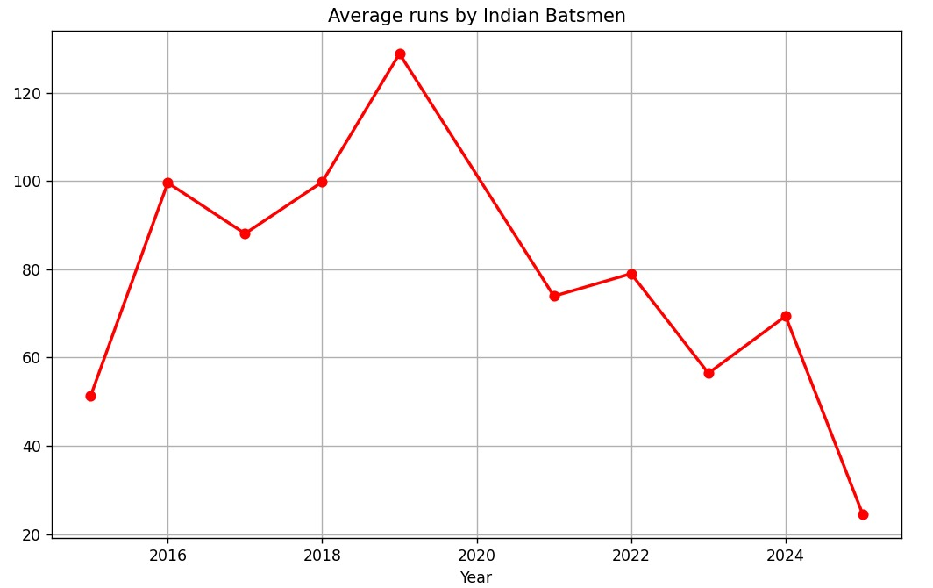
Key Visualizations
Yearly Average Runs
Shows the actual "Downfall" trend over 2015-2025, revealing the gradual decline in innings totals, as we can see the year 2019 has highest average, but since then the graph has a drop-off.

Slide 10
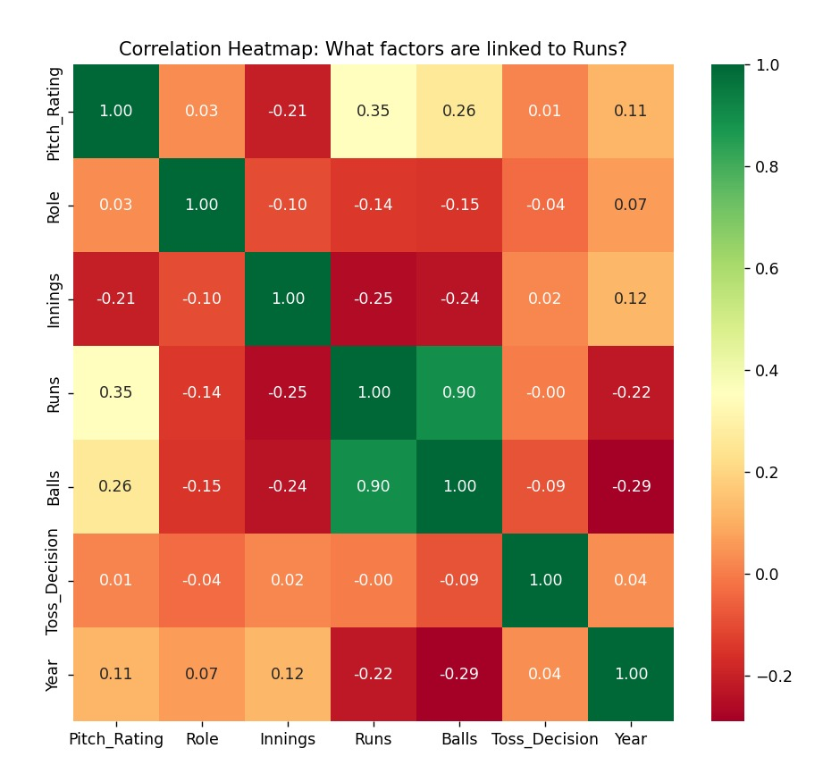
Feature Comparison: Runs Vs Other Factors
The heatmap suggests that balls faced and pitch conditions are the most influential factors for run scoring, while variables like toss decision and player role have minimal impact. It also indicates a slight downward trend in run scoring across years and innings.

Slide 11
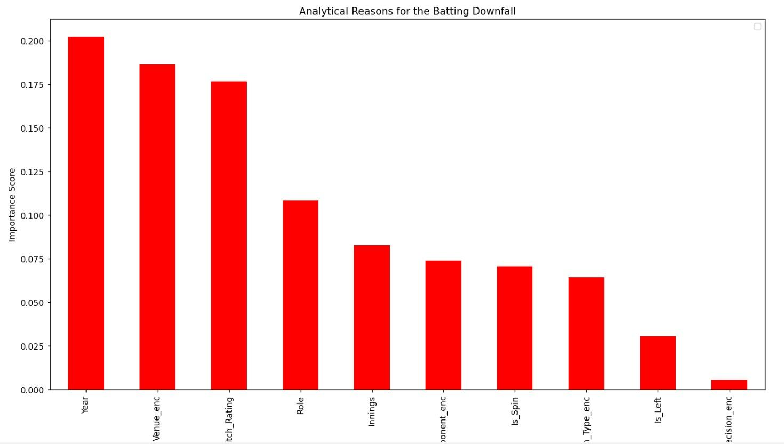
Feature Importance
Bar chart shows what the model identifies as most important drivers of scoring performance, as you can observe, year and venue are most impactful metrics when cosodereing analyzing the downfall. Year indicates its not just other factors but batsmen from dip as years pass by.

Slide 12
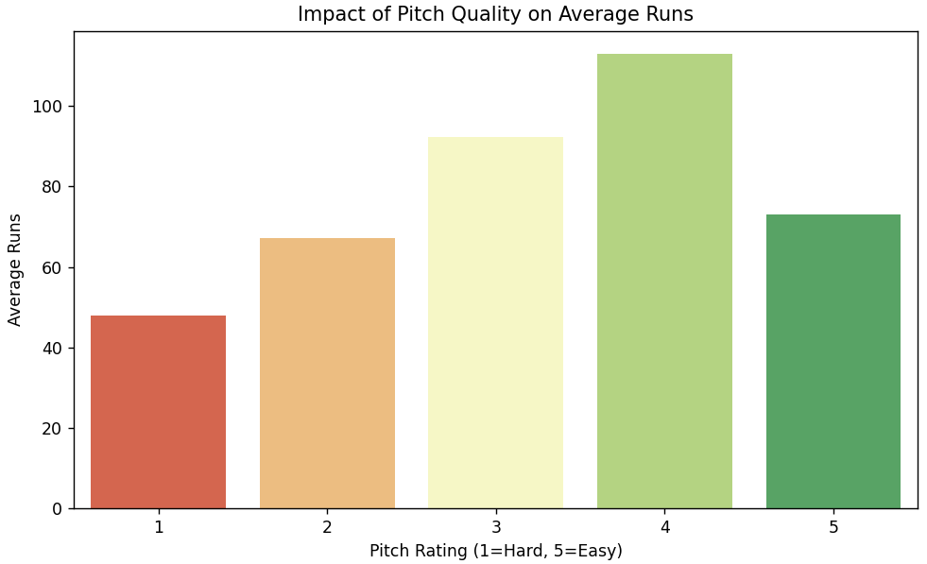
Pitch Rating vs. Average Runs
Reveals whether pitches are getting harder to bat on, the downfall isn't just players losing form; it's the fact that these extreme pitches make it mathematically improbable to score big runs.

Slide 13
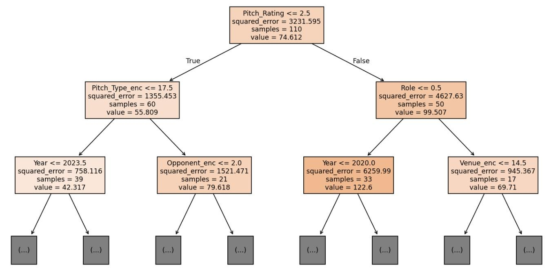
Decision Tree
This is one of the decision tree considered in Random Forest Regression Model. This shows how classification is made when considering factors for analysis. Here Pitch_rating, Pitch_type, year, opponent, role and venue are considered for classification

Slide 14

Performance: Training vs. Testing Accuracy
0.58
0.01
34.59
Training R² Score
Testing R² Score
Mean Absolute Error
The model learned historical patterns very well, showing strong pattern recognition
High volatility in cricket scores makes prediction difficult, but positive score proves better than random guessing
This error margin proves that individual cricket innings still have a massive 'human element' or 'luck factor' worth about 35 runs.
Key Interpretation
The significant gap between 0.58 and 0.01 highlights how unpredictable modern Indian tracks have become even a sophisticated model struggles with the high variance in scoring patterns.

Slide 15
Findings & Conclusion
Primary Driver
Chronological Decline
Technical Insight
Pitch Rating emerged as the most influential factor in batting performance decline
Year ranking as a top factor suggests a systemic decline that isn't just about pitch surfaces it reflects broader changes
If Is_Spin ranked high in importance, the downfall is technically linked to spin-playing ability and technique against spin bowling
Final Word: The "Downfall" is a measurable reality, driven largely by environmental (pitch) and temporal (time) factors. The analysis provides quantifiable evidence of performance decline beyond anecdotal observations.

